Slide 1
Filtering: denoising

Slide 2
Signals and noise
The digital signal acquisition process, as a result of experimental measurements, is far from being perfect. Usually, we have two types of measurement errors:
systematic error, i.e., the signal have a constant or relative bias
random error, unpredictable variations in the measured signal, often called noise
There are many sources and many types of noise. It can be random or white noise (equally distributed in frequency), or frequency-dependent noise, or impulse noise
Knowing the kind of noise, the signal suffers, helps in choosing the right filter to remove (or alleviate) it
Notes:
There are many sources of noise, knowing the kind of noise the signal suffers, helps in choosing the right filter to remove (or alleviate) it.
We will introduce two very common kind of noise: additive white Gaussian noise and impulsive noise.

Slide 3
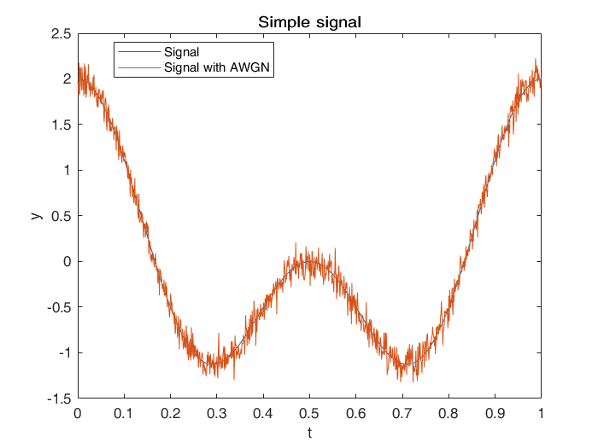
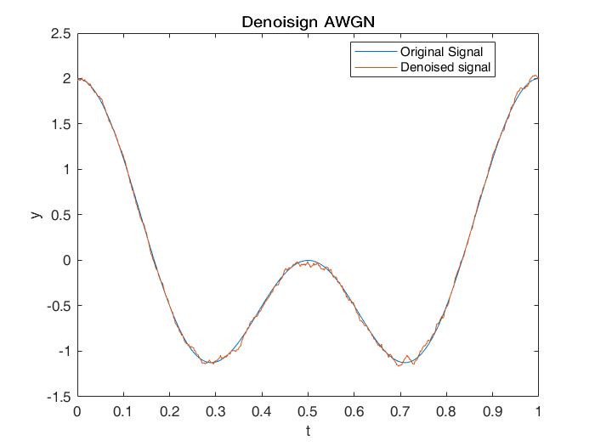
Example: white noise
In a digital signal, white noise samples are a sequence of serially uncorrelated random variables with zero mean and finite variance.
When each sample has a normal distribution with zero means, the noise is said to be additive white Gaussian noise (AWGN)
In order to remove this kind of noise, a simple approach is to use a smoothing filter
Notes:
One of the most common kind of noise is the additive white Gaussian noise.
In order to remove this kind of noise, a simple approach is to use a smoothing filter

Slide 4
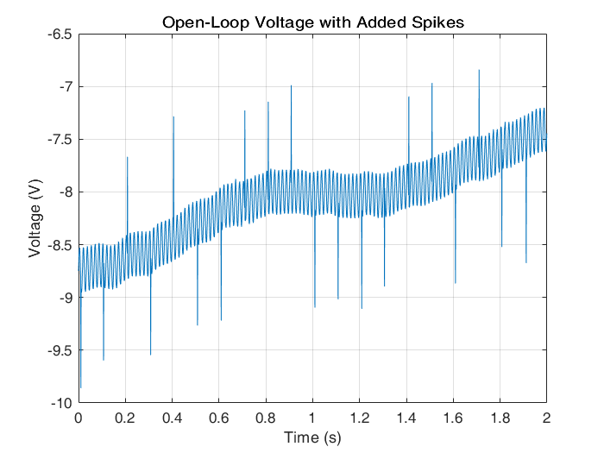
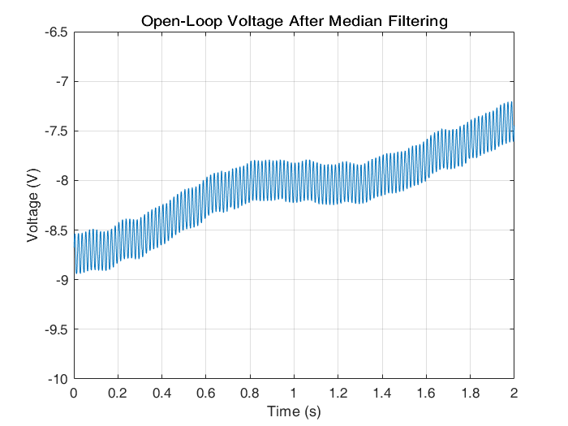
Example: Impulse noise
Impulse noise is characterized by unwanted, almost instantaneous impulse-like disturbance in the signal (spikes)
It is common in acoustic signals and images, where is known as salt-and-pepper noise (i.e., sparse white and black pixels in images)
A classic filter used to remove impulse noise is the median filter, where a sample is replaced by the median values of its neighborhoods
Notes:
Impulse noise is characterized by unwanted, almost instantaneous impulse-like disturbance in the signal (spikes)
A classic filter used to remove impulse noise is the median filter

